Slide 1
Lego Database Analyze
Jingru & Moran

Slide 2
Dataset
LEGO is a popular brand of toy building bricks that are often sold in sets which contains a number of parts in different shapes, sizes and colors.
The data was collected on July 2017. Include 60 years information.
This database contains information on which parts are included in different LEGO sets.

Slide 3
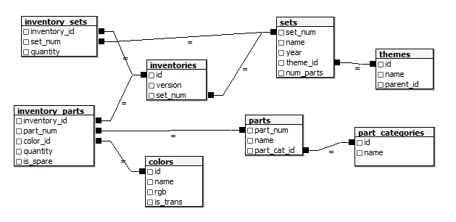
Dataset
Lego Database: https://www.kaggle.com/rtatman/lego-database

Slide 4
Motivation
Customers: Help people who owned some LEGO sets already figure out what other sets they could build with the pieces they had.
Company: Have an overview of the color and themes change over years. To understand the most and rarest used colors and parts in Lego sets among these 60 years.

Slide 5
Research Question
How have the size of sets changed over time?
What colors are associated with witch themes?
Could you predict which theme a set is from just by the bricks it contains?
What sets have the most-used pieces in them?
What sets have the rarest pieces in them?
Have the colors of LEGOs included in sets changed over time?

Slide 6
Data Cleaning
There are two tables contain missing values. colors and themes.
In colors table, some of the color name are write as unknown.
The themes table has two columns: “name” and “parent_id”. There are 111 missing values on “parent_id” column.
we decided to keep these “unknown” in the table instead of deleting them. Those missing values will not influence our analyze,delete may cause count mistake.

Slide 7
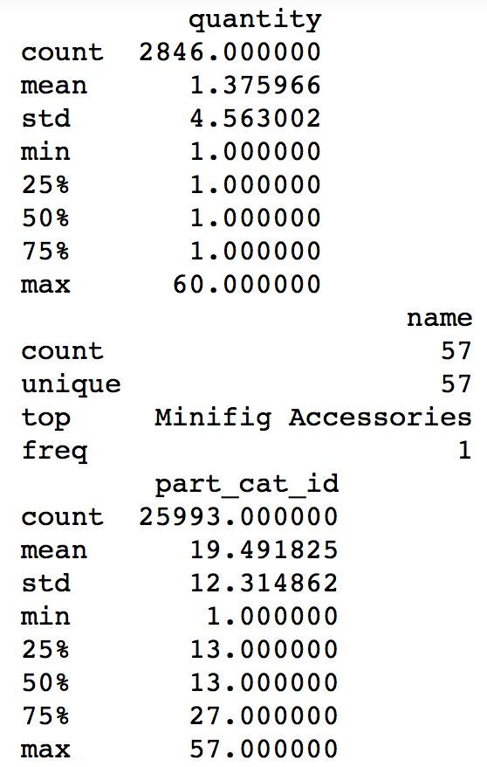
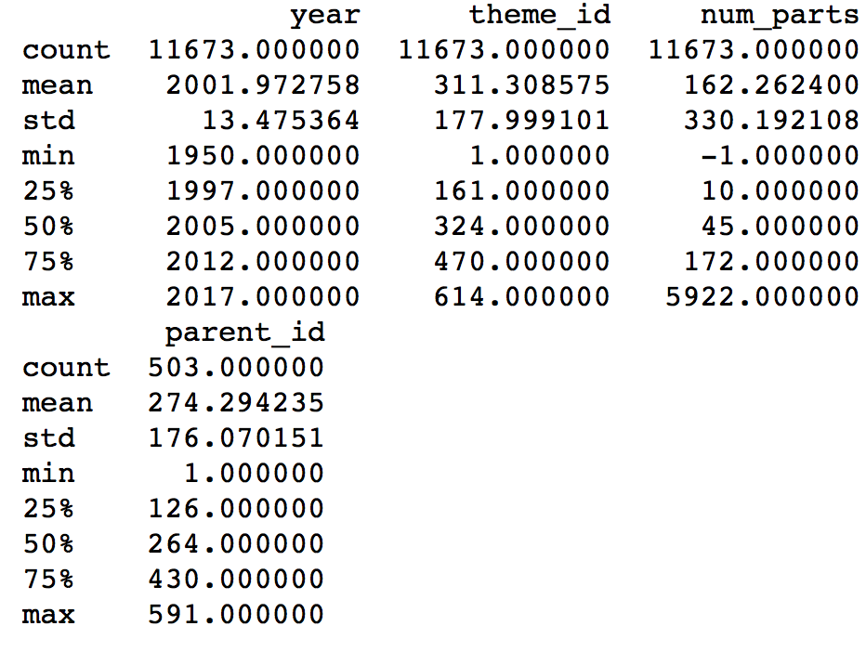
Summary Statistic (Before Any Merge)

Slide 8
Prepare Data
Join theme , set , inventory, inventory sets, inventory parts, parts, colors

Slide 9
Have the colors of LEGOs included in sets changed over time?

Slide 10
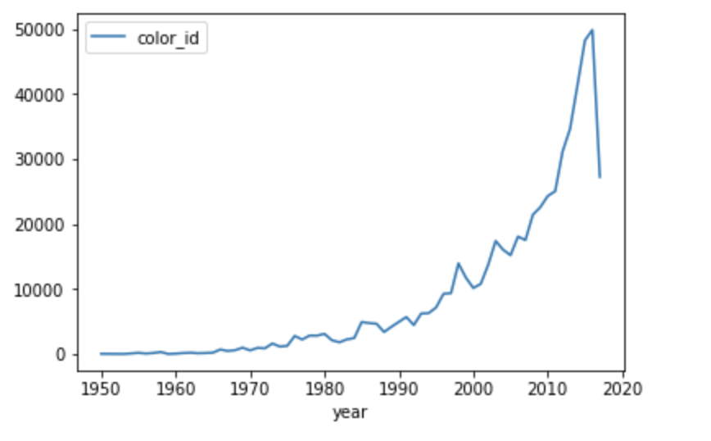
Color used for different parts by years
The number of color increased to 49904 on 2016 and decreased sharply to 27282 in next year.

Slide 11
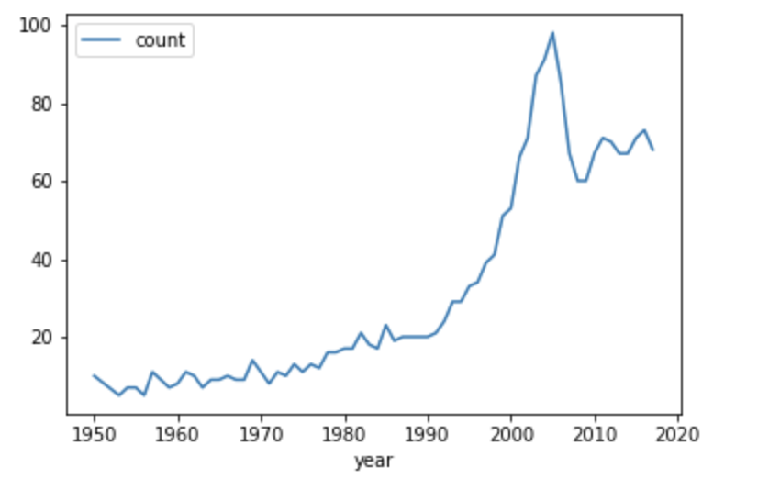
Number of Unique colors used in years
Number of colors increase to 98 and starts to decrease since 2005.

Slide 12
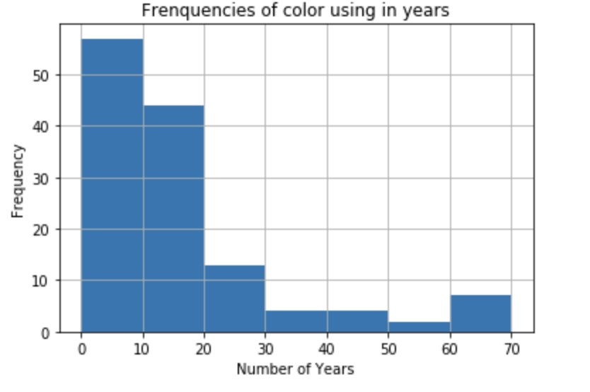
Years of color exist
131 colors been used. Seven colors were used for more than 60 years. 61 colors were added in these 10 years.

Slide 13
How have the size of set changed over time?

Slide 14
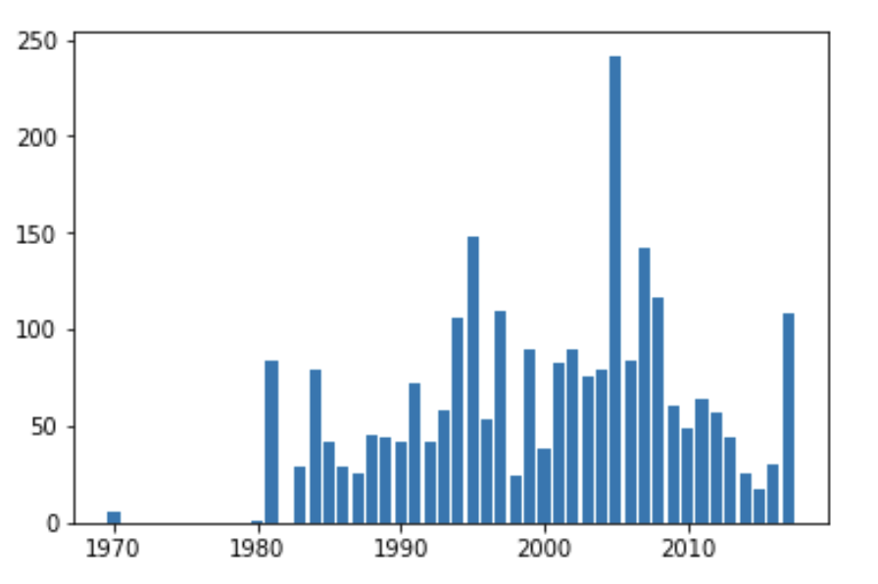
Year of size of sets
The size of sets increase to 5000 in 2005 and start to decrease science 2005.
Since 2005, the size of sets decrease until to
Notes:
In 2005, lego company start to increase the color of parts. More and more parts have unique colors. So one sets may have more unique color parts. More parts.

Slide 15
What sets have the rarest pieces in them?
Notes:
Get the set name that the parts in this set are not appears in other sets
And count how many these rarest parts in each set

Slide 16
Visualization
file:///private/var/folders/qk/1f1kj4117sl5qwdf072395nm0000gn/T/tmptfqgjeph.html

Slide 17
What sets have the most-used pieces in them?

Slide 18
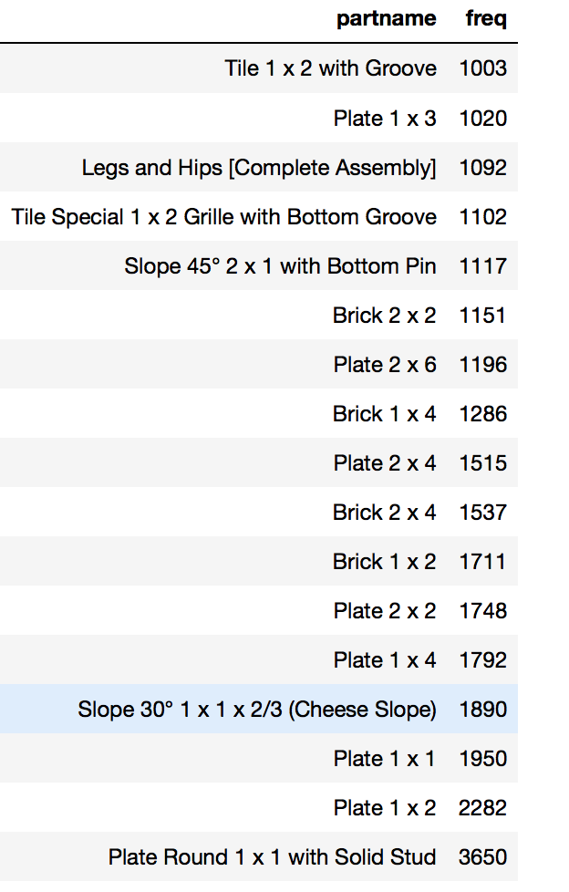
17 pieces are used by more than 1000 sets. The most frequent one is been used in 3650 sets.

Slide 19
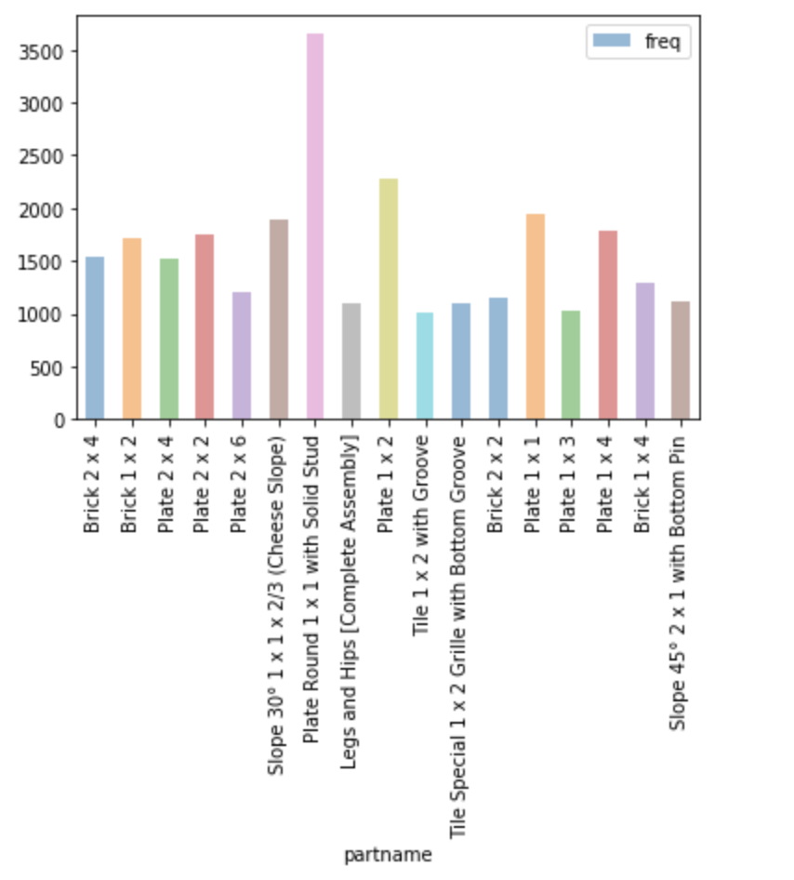
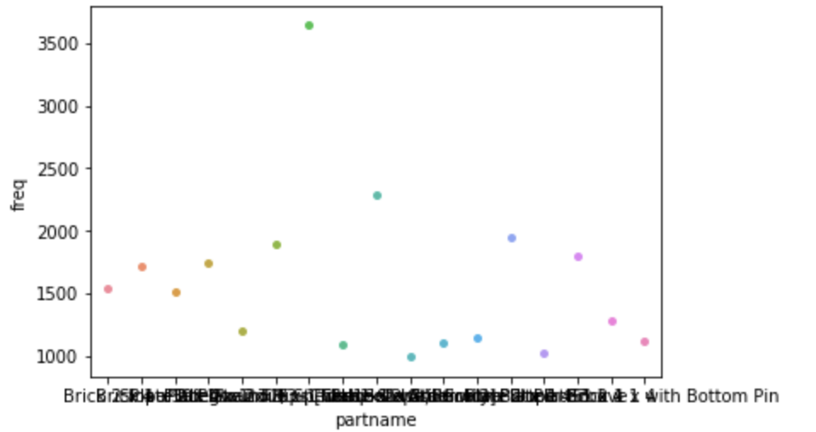
Graph

Slide 20
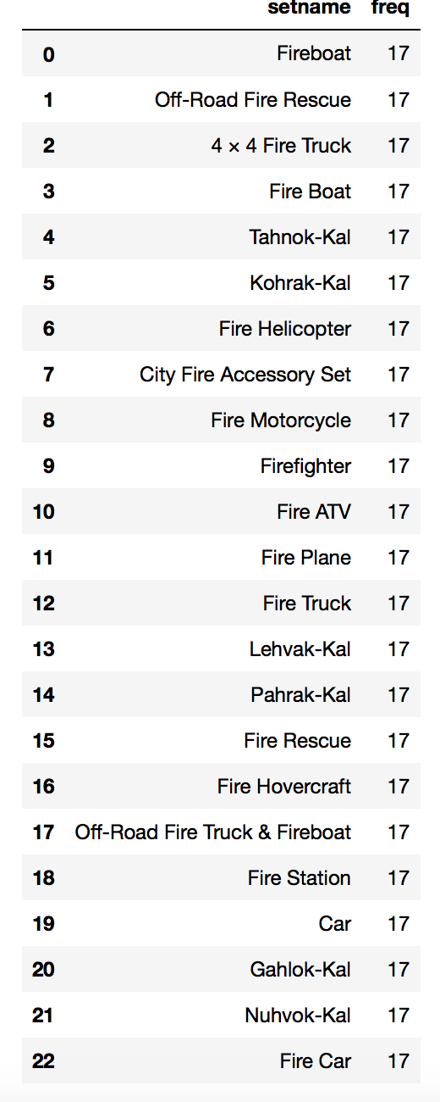
Sets contain the most-used pieces in them

Slide 21
What colors are associated with which themes?

Slide 22
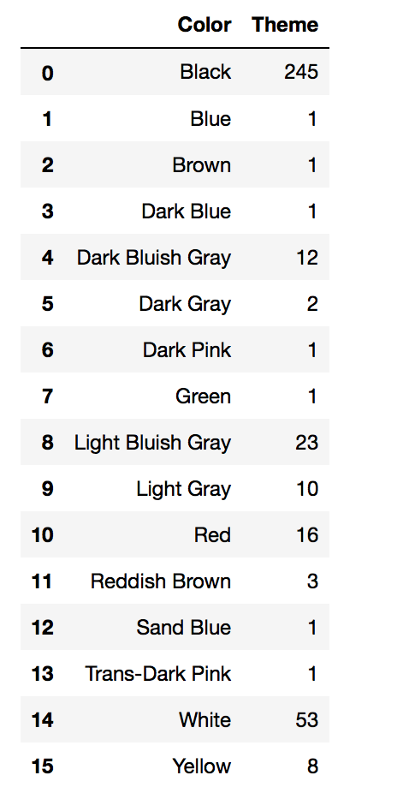
The number of colors as the most frequent color for each themes. Black is the most frequent color in 245 themes.

Slide 23
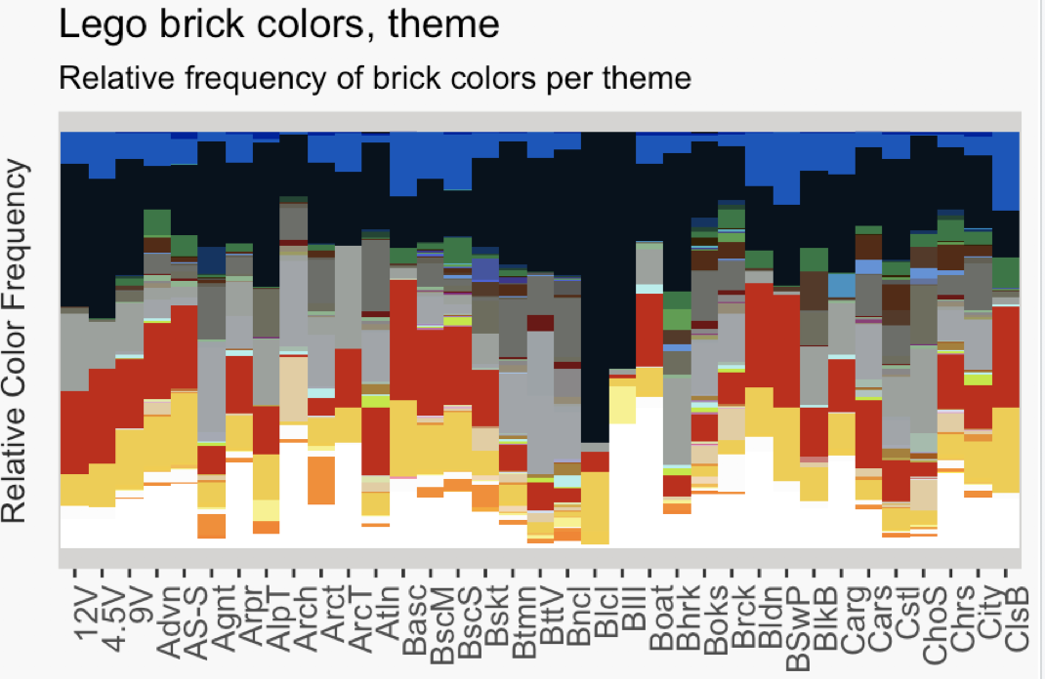
Notes:
12V 4.5V 9V
Advent Advent Sub-Set Agents
Airport Alpha Team Architecture
[10] Arctic Arctic Technic Atlantis
[13] Basic Basic Model Basic Set
[16] Basketball Batman Battle Vehicles
[19] Bionicle Blacktron I Blacktron II
[22] Boat Bohrok Books
[25] Bricktober Building Building Set with People
[28] Bulk Bricks Cargo Cars
[31] Castle Chamber of Secrets Christmas
[34] City Classic Basic

Slide 24
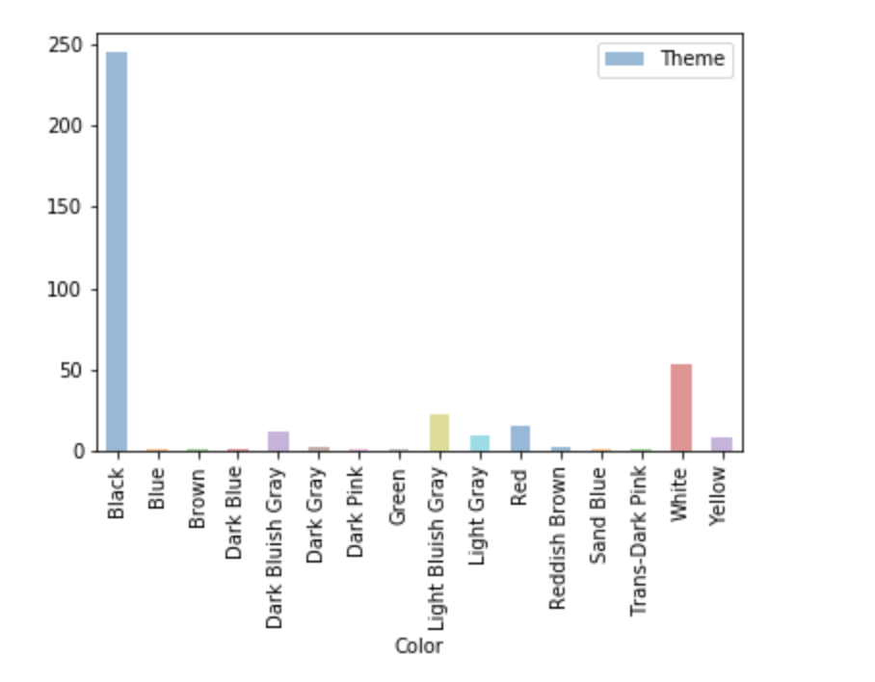
Graph

Slide 25
Predict which theme a set is from by the bricks it contains

Slide 26
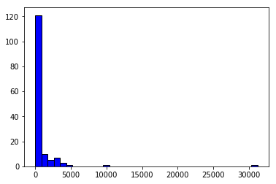
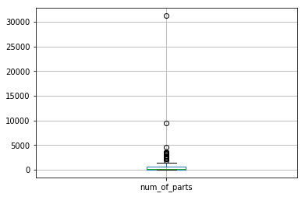
Features Visualization
Count how many parts in each sets
Frequency of Count BoxPlot of Count
Notes:
Count how many parts in each sets.
From both graph, many themes includes less than 2000 parts.
Find a theme which has over 30000 parts, interested in what is this theme? Why this theme has so many parts? Is this a outlier? Or Is this indicates the way we manipulate data is wrong?

Slide 27
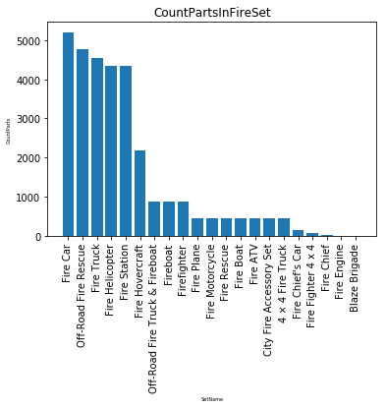
The Extreme Points Are Outliers?
The largest points indicates the theme FIRE.
FIRE includes 21 different sets.

Slide 28
Predict Theme Name by Parts It Contains
Using part name to predict the theme name.
Why using Naive Bayes?
Predict categorical variables ( there are 149 unique theme)
Explanatory variable is categorical

Slide 29
Assumption
Using label encoder to convert categorical explanatory variable to numeric variable
After convert, assume the distribution of the new column is normal distribution
Naive Bayes assume explanatory variables are independence and equally contribute to the independent variable

Slide 30
Model Evaluation
Accuracy is 0.247
Why the accuracy is so low?
Too much theme names in the data set
Not enough explanatory variables to predict the feature of the theme
Double check the model
Notes:
Maybe some theme name just occur 1 or 2 times. Occur less time.

Slide 31
Finding/Evaluation
Lego has 131 unique colors
Most popular colors are white, black ,red, yellow and blue among both sets and parts.
Year 2005 has got maximum unique colors.
Year 2016, the Lego color has got huge reduction
The most frequent piece has been used in 3650 sets.

